Slide 1
Price Controls Cause Chaos
Brian C. Albrecht
ICLE
Alex Tabarrok
George Mason University
Mark Whitmeyer
Arizona State University

Slide 2
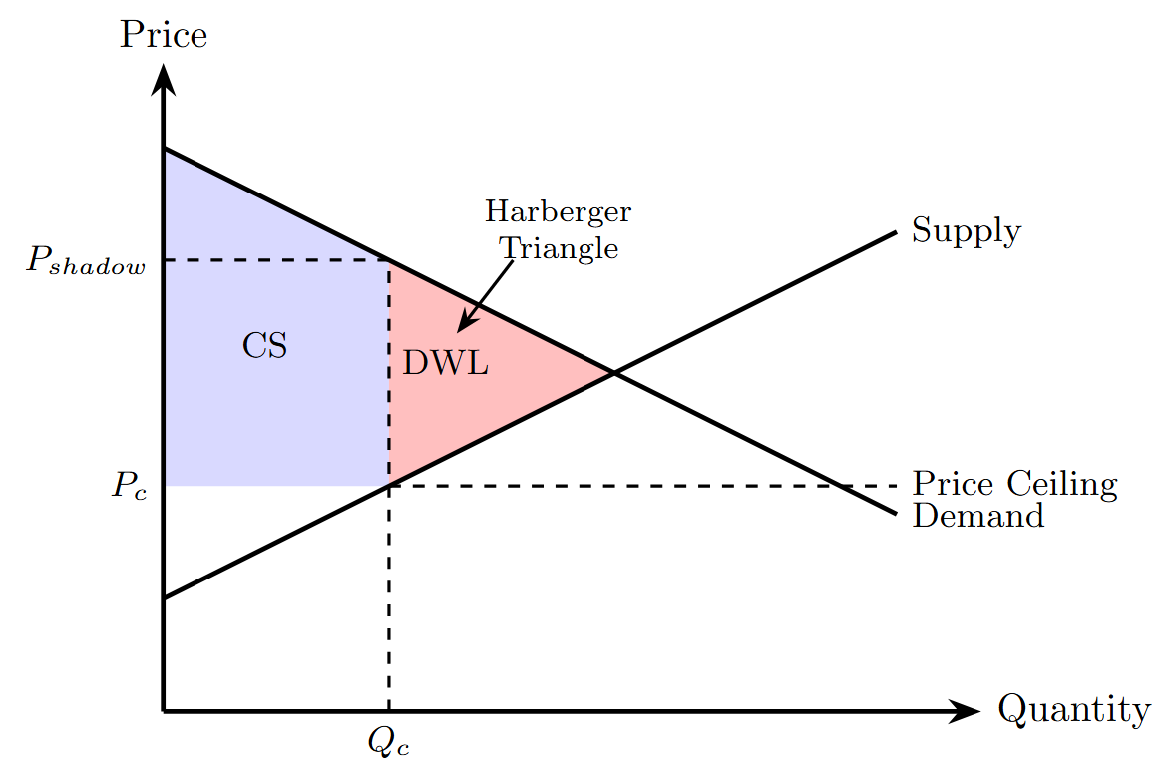
Harberger Triangle
Econ 101: A price ceiling at Pc creates DWL given by the Harberger Triangle.
But note that this assumes that allocation is efficient. That is it assumes that the Qc of output is allocated to the demanders with the highest willingness to pay (WTP).
But why should this be?
Note that there are many more people willing to pay a price higher than Pc.
How can the consumers with the highest willingness to pay outbid consumers with a lower WTP when prices are fixed by law?
Demanders
with Highest
WTP
A price ceiling at Pc creates DWL given by the Harberger Triangle

Slide 3
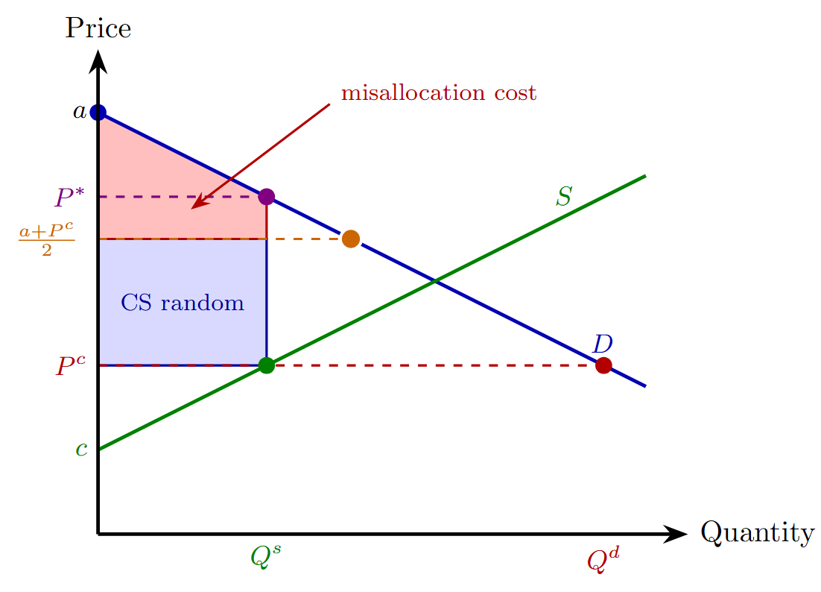
Random Allocation
A natural response is to ask what happens under random allocation?
Since under random allocation some output now goes to consumers who value it less than the highest willingness to pay, deadweight loss increases.
By how much?
Two neat visuals.
Harberger Triangle

Slide 4
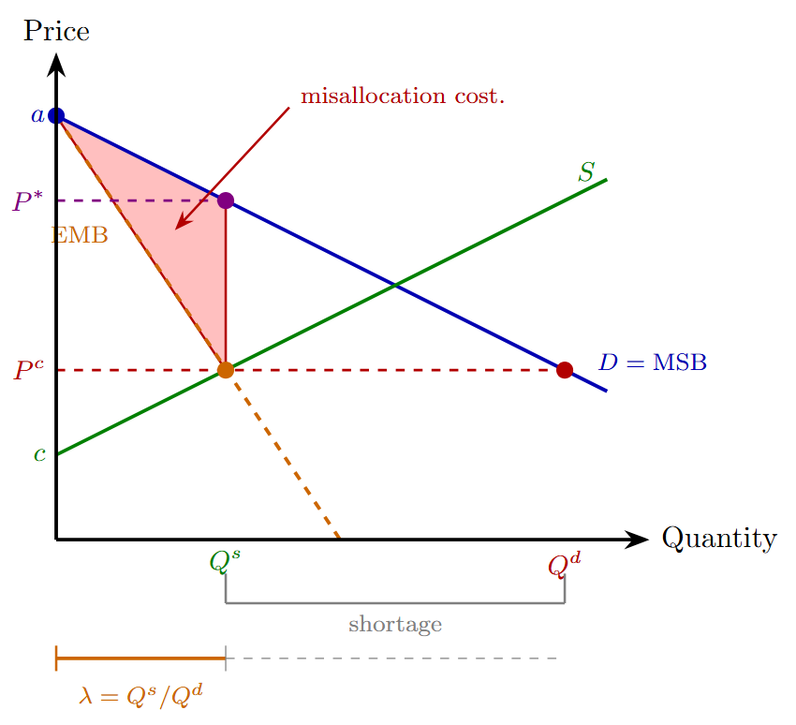
Random Allocation
A natural response is to ask what happens under random allocation?
Since under random allocation some output now goes to consumers who value it less than the highest willingness to pay, deadweight loss increases.
By how much?
Two neat visuals.
Harberger Triangle

Slide 5
Random Allocation
Random allocation has been studied by Glaeser and Luttmer (2003) and Bulow and Klemperer (2012) (among others).
Glaser and Luttmer (2003) argue that 21% of the apartments under NYC rent control are misallocated—leading to substantial welfare losses.
Bulow and Klemperer study when random allocation result in large misallocation losses: Requires information on log convexity, log concavity etc. of demand curves. Not obvious!
We study all possible allocations to different market segments.

Slide 6
Segments
Think about market segments: geographic, temporal, input-output....
For the Harberger triangle to represent DWL requires that shadow prices be equalized in all segments such that the sum of the segment quantities equals the quantity supplied at the controlled price.
Notes:
Note shadow prices. Note we from herein we ignore production deadweight loss as this will be constant across all misallocations (e.g. oil from foreign country).

Slide 7
Segments
Why should shadow prices equalize when fixed money prices eliminate arbitrage incentives?
Note in Panel B segment 2 gets zero allocation and segment 1 gets over-allocation.
As a result a+b>c

Slide 8
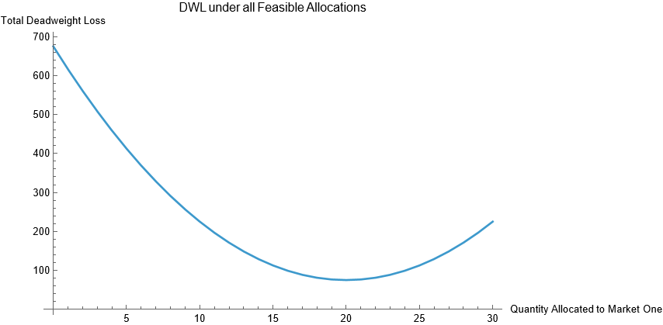
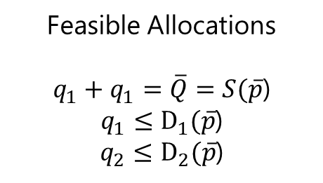
What is possible?
Feasible Allocations
$q_{1}+q_{1}=\overline{Q}=S(\overline{p}$)
$q_{1}≤D_{1}(\overline{p}$)
$q_{2}≤D_{2}(\overline{p}$)
Vertex
Allocations
Harberger

Slide 9
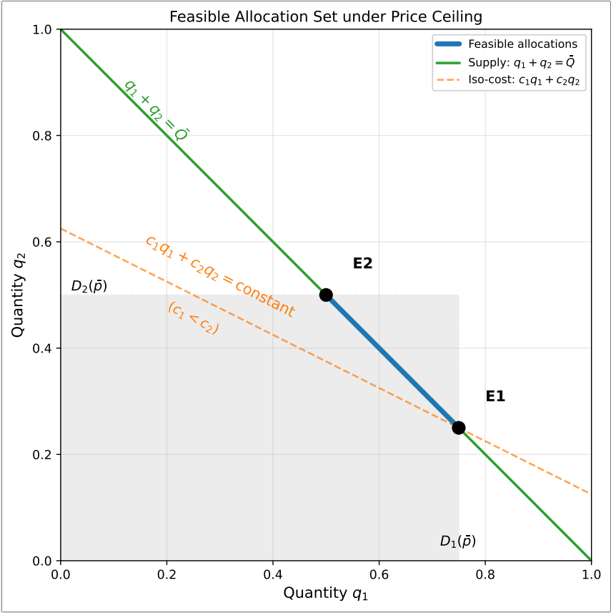
Why Vertex Allocations?
Think of transportation costs. Two markets. Prices are fixed. To which do you deliver? Ideally, deliver everything to the market with lowest transport cost.
More generally: the feasibility constraints are shown at right. Convex polytope. Linear program->Corner solutions.
Any outcome from E2 to E1 is feasible but generically the outcomes are E2 and E1 depending on transport costs.
“Segment”, “Transport”—very general terms.

Slide 10

The Rise of Nuisance Parameters
As Yergin (1991) describes, ''gasoline was in short supply in major urban areas, but there were more than abundant supplies in rural and vacation areas, where the only shortage was of tourists.”
In a free market, a slight cost advantage for Pennsylvania over New Jersey matters only at the margin—a few tanker loads of oil—not all of them.
The price mechanism permits fine-grained reallocation because arbitrageurs capture profits proportional to the price gap.
When prizes are frozen, these incremental profit opportunities disappear.
Nuisance parameters become all important.
Notes:
1979 Barely 50 stations were open in Connecticut.and in New Jersey less than 500 of thestate's 6,1m stations were open. In New YorkCity, Westchester County and Long Island,less than 5 per cent of the stations sold gasoline. Police call for help in qasoline riots Chicago Tribune (1979) Chicago, Ill.. 26 June 1979:2

Slide 11
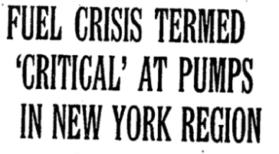
In Connecticut, state energy officials had expected 150 stations to be open yesterday; barely 50 were. Of New Jersey's 6,000 stations, less than 8 percent pumped gas yesterday, officials said, and in New York City, in Westchester County and on Long Island, less than 5 percent of nearly 5,000 service stations were open.

